Slide 1
Carbon Crowd
Meeting 10/30/2023
Epiphyte Tidying-up
First evidence of CO2 (and H2O) capture

Slide 2
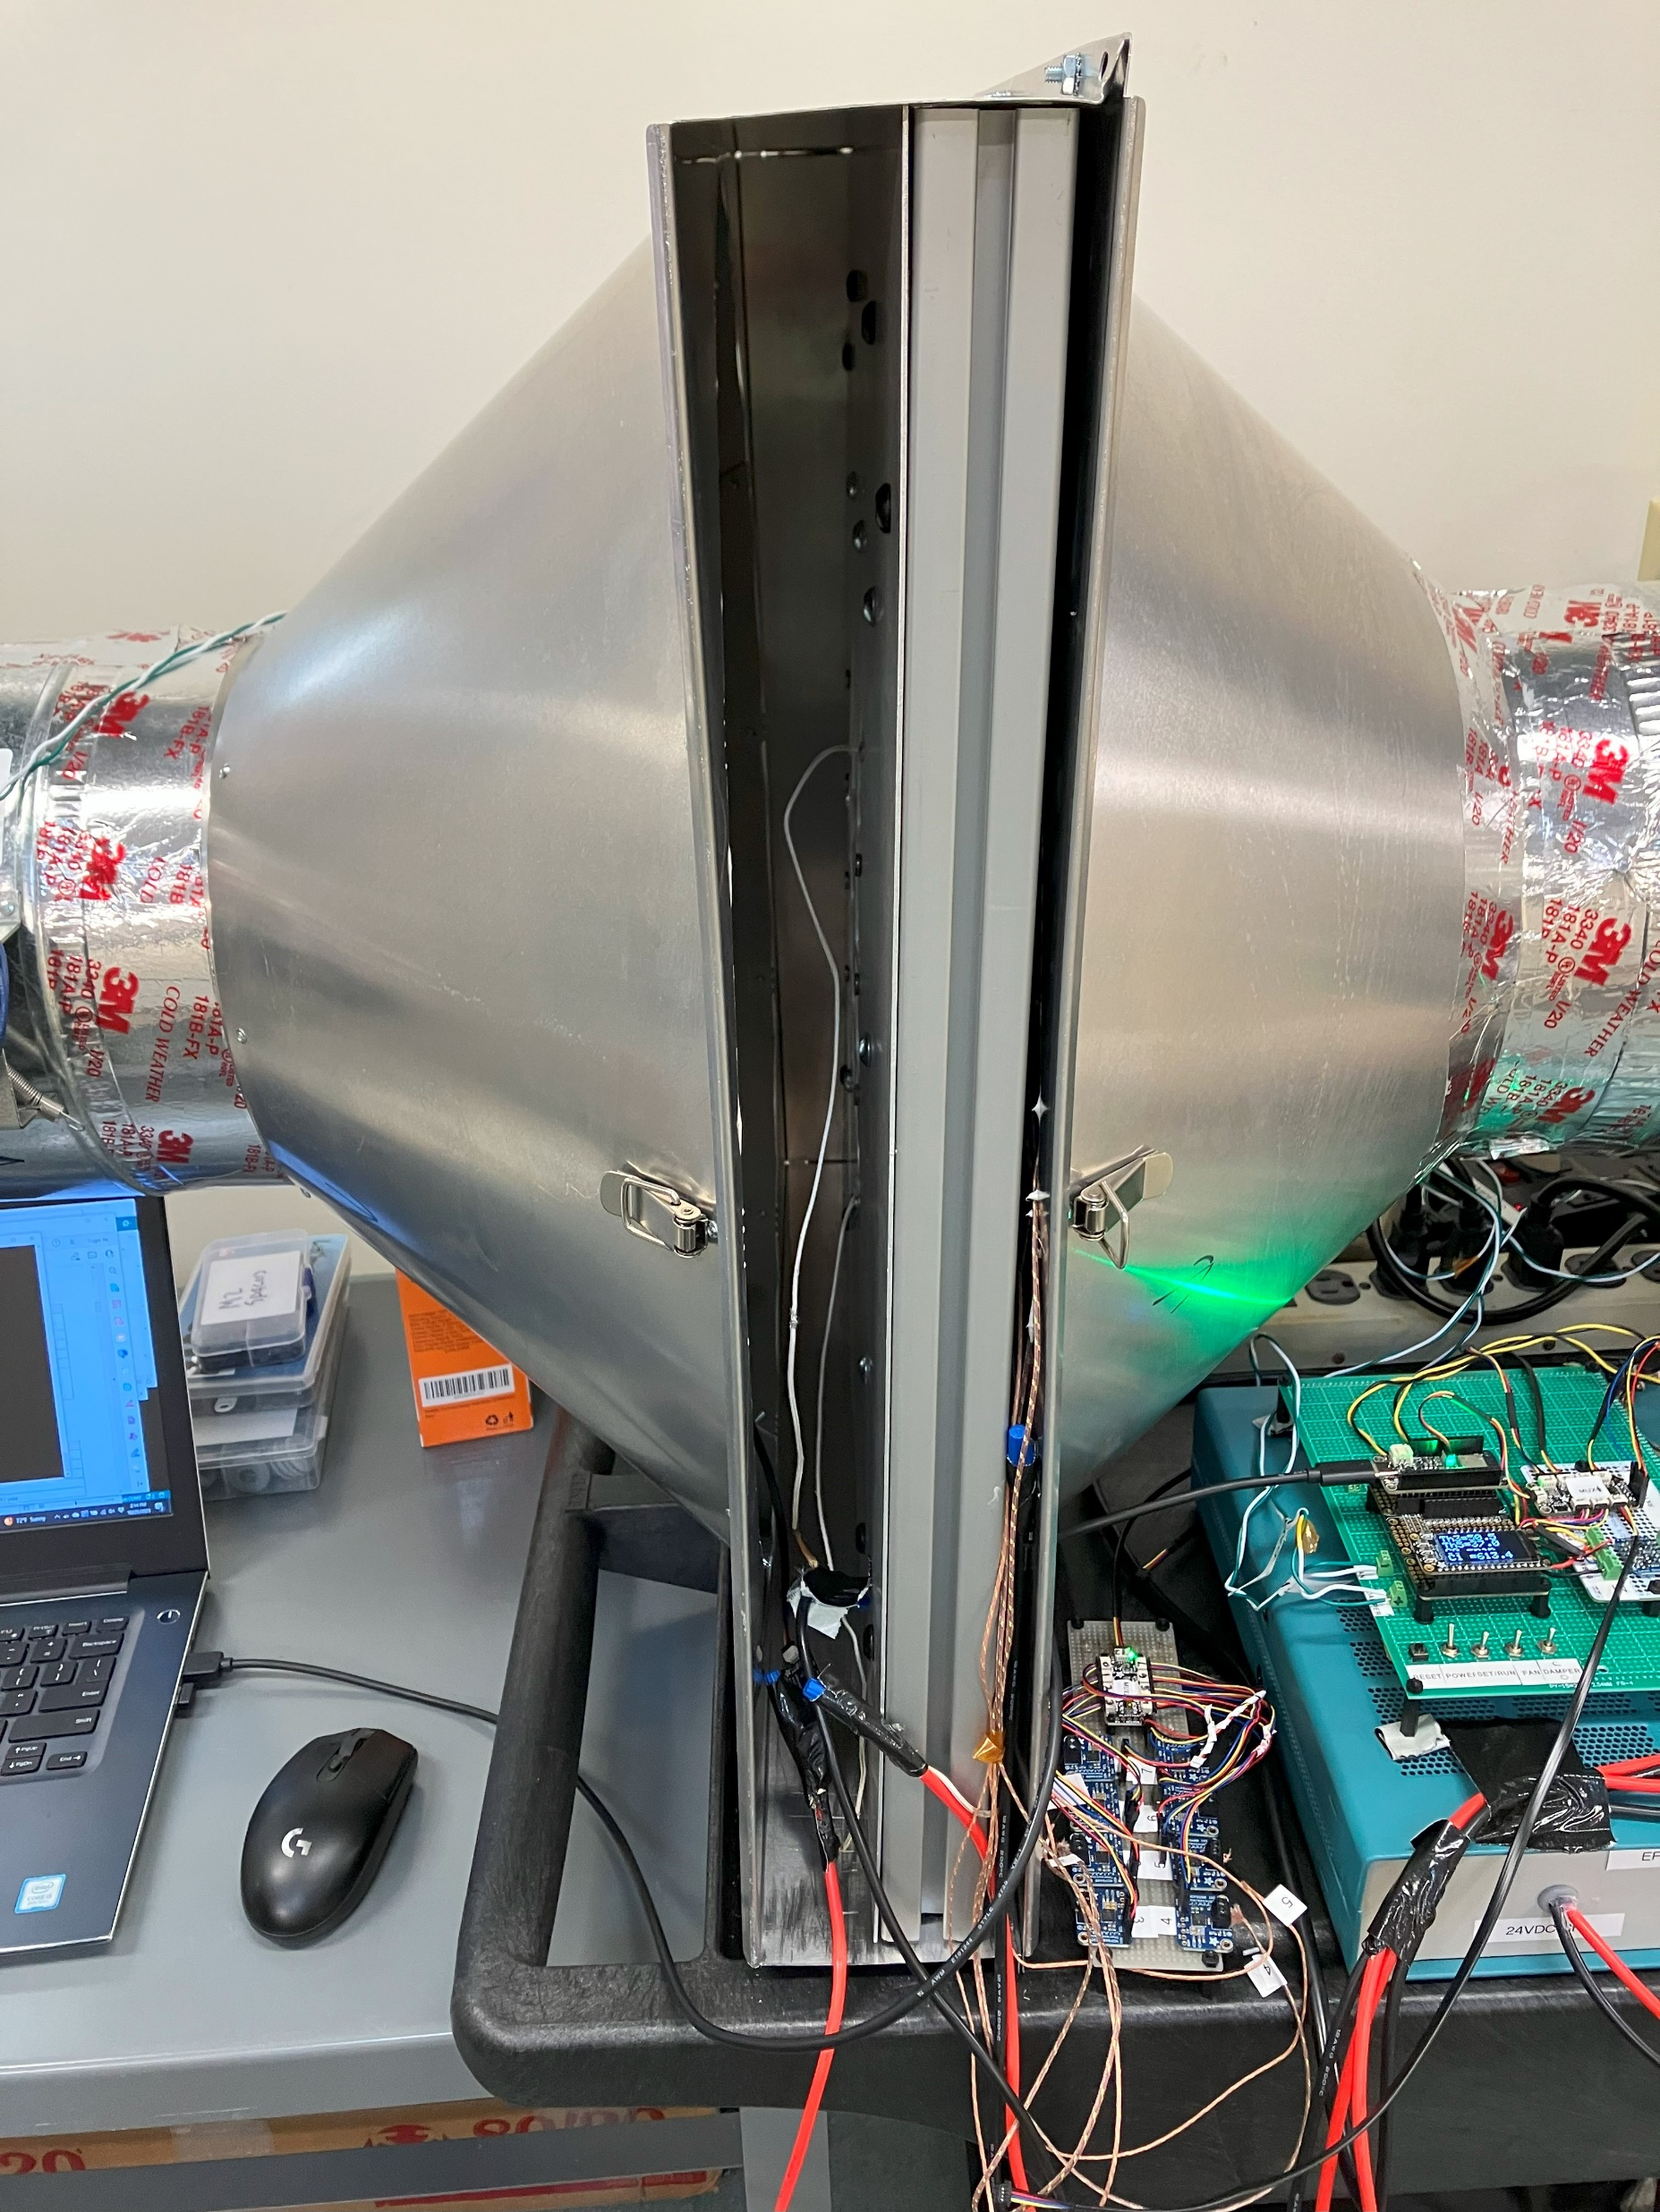
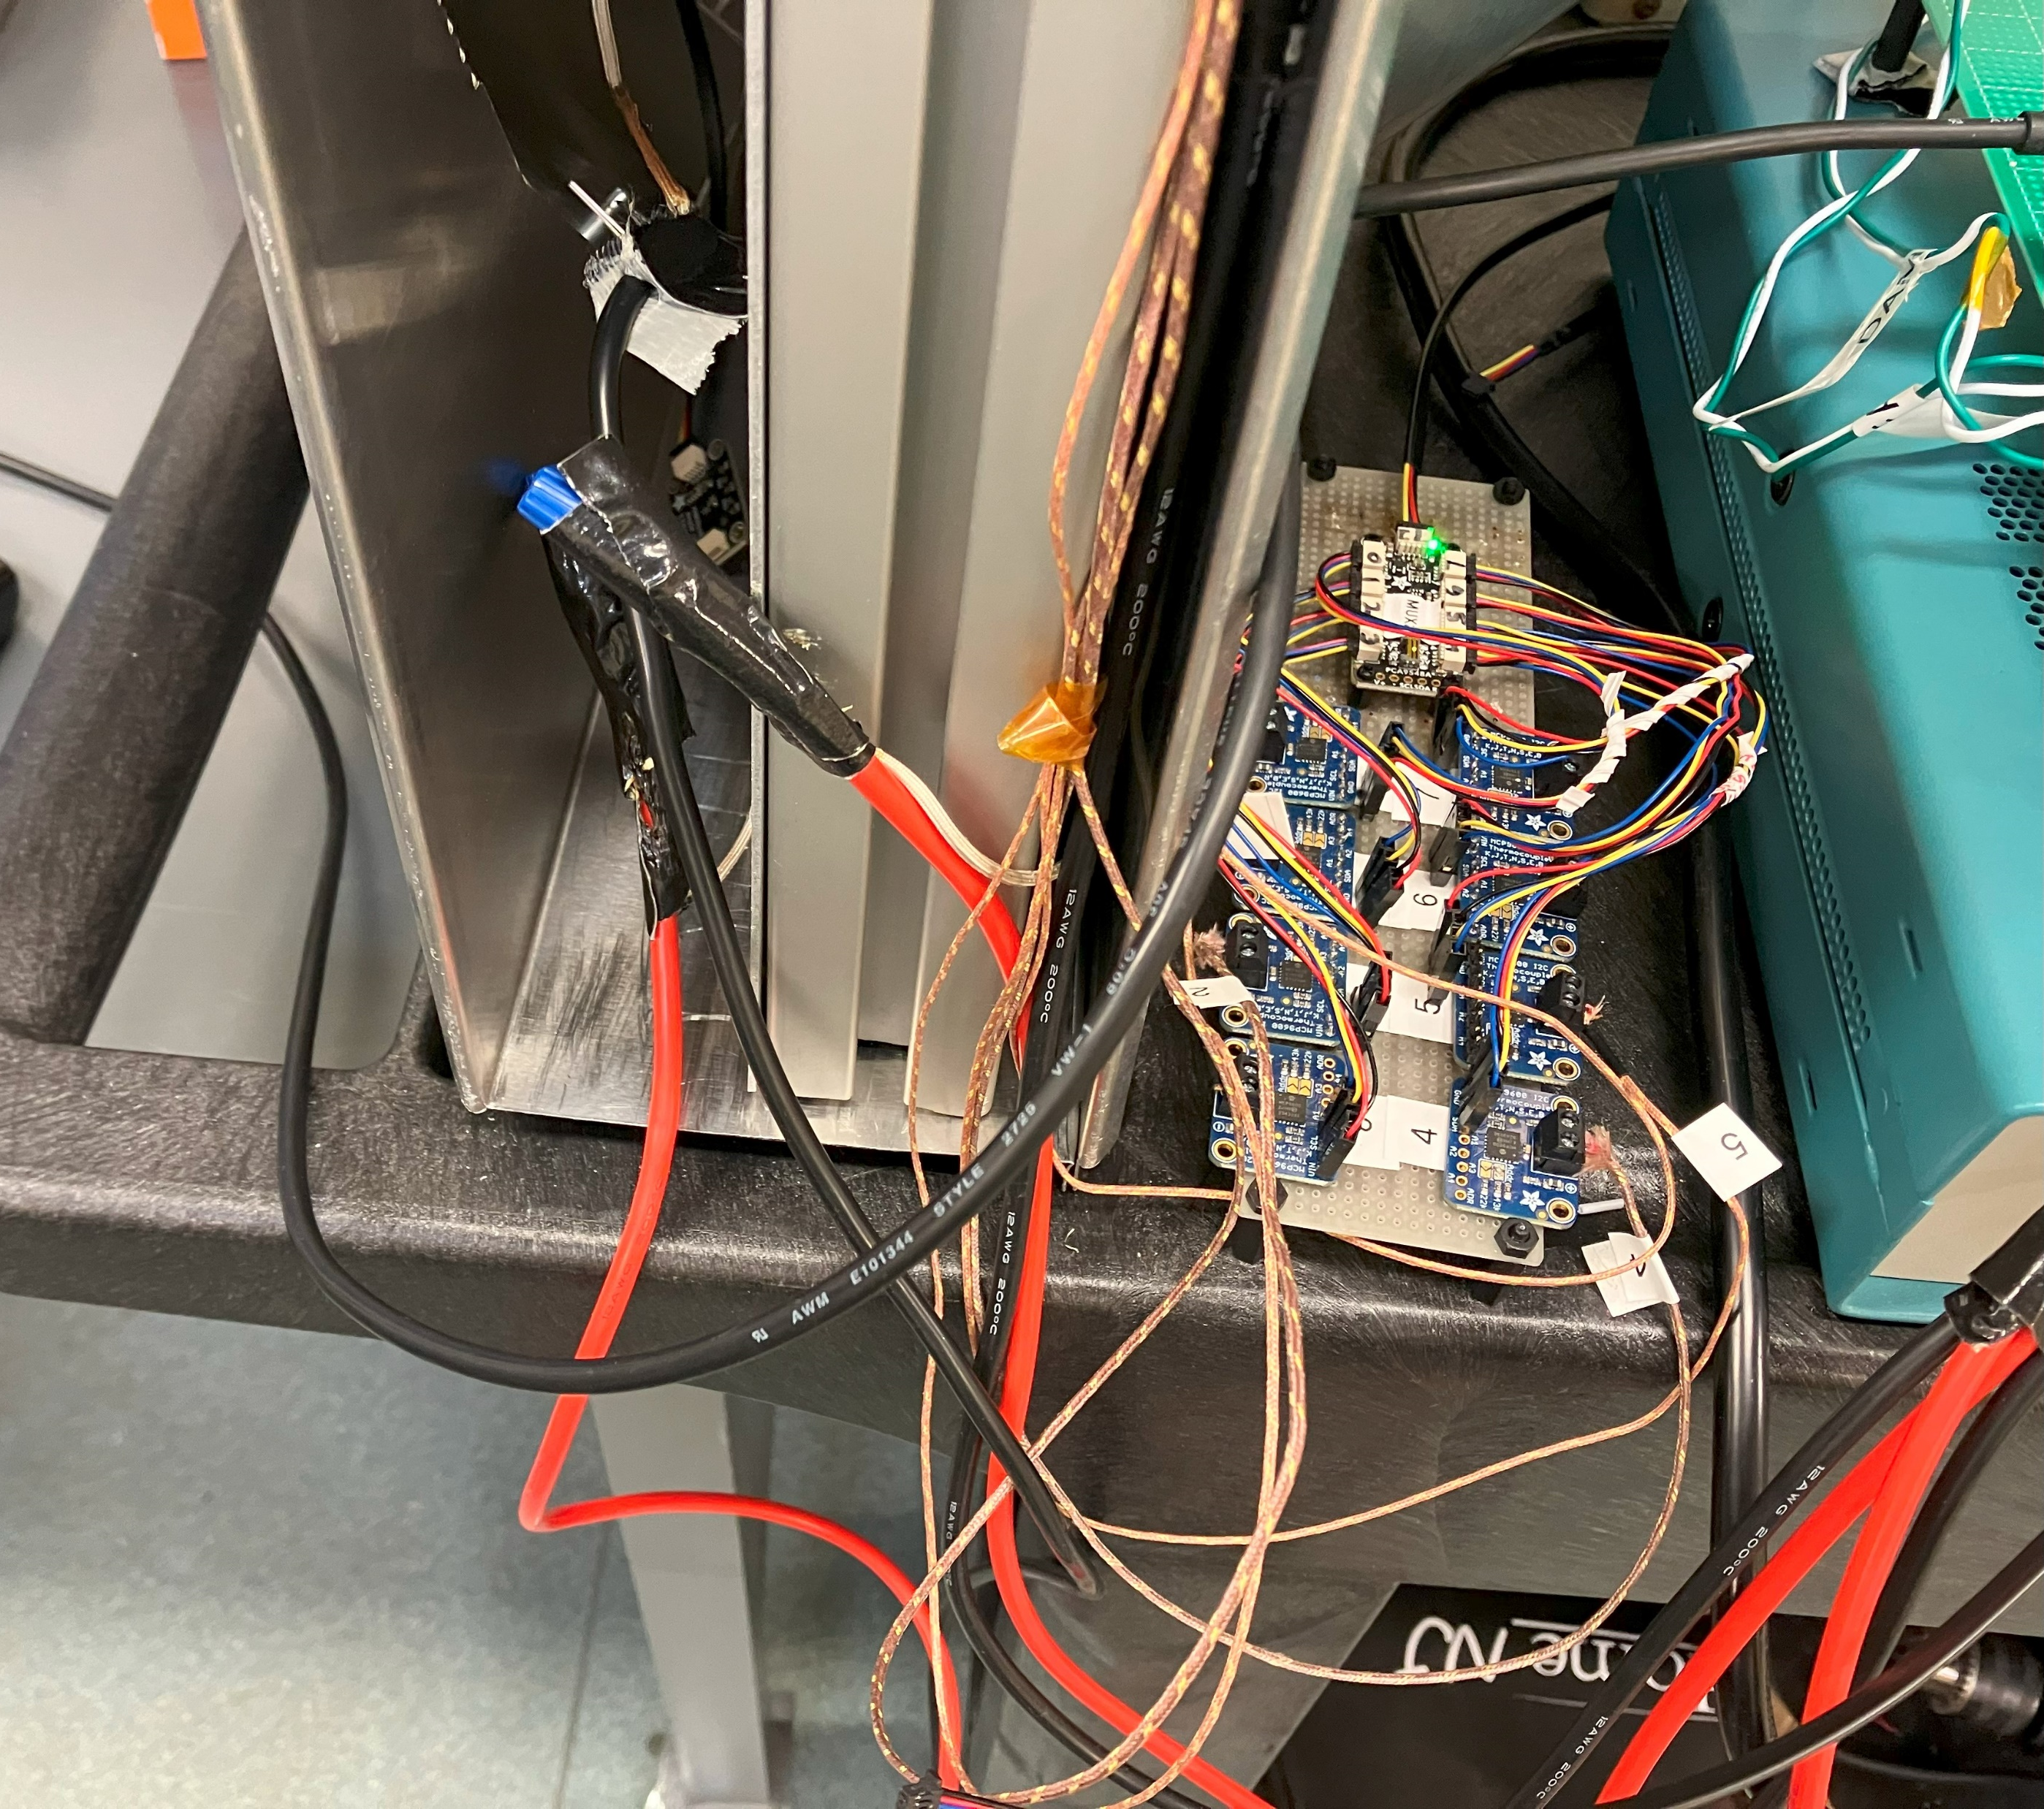
Sorbent Panel Cleanup
Before…

Slide 3
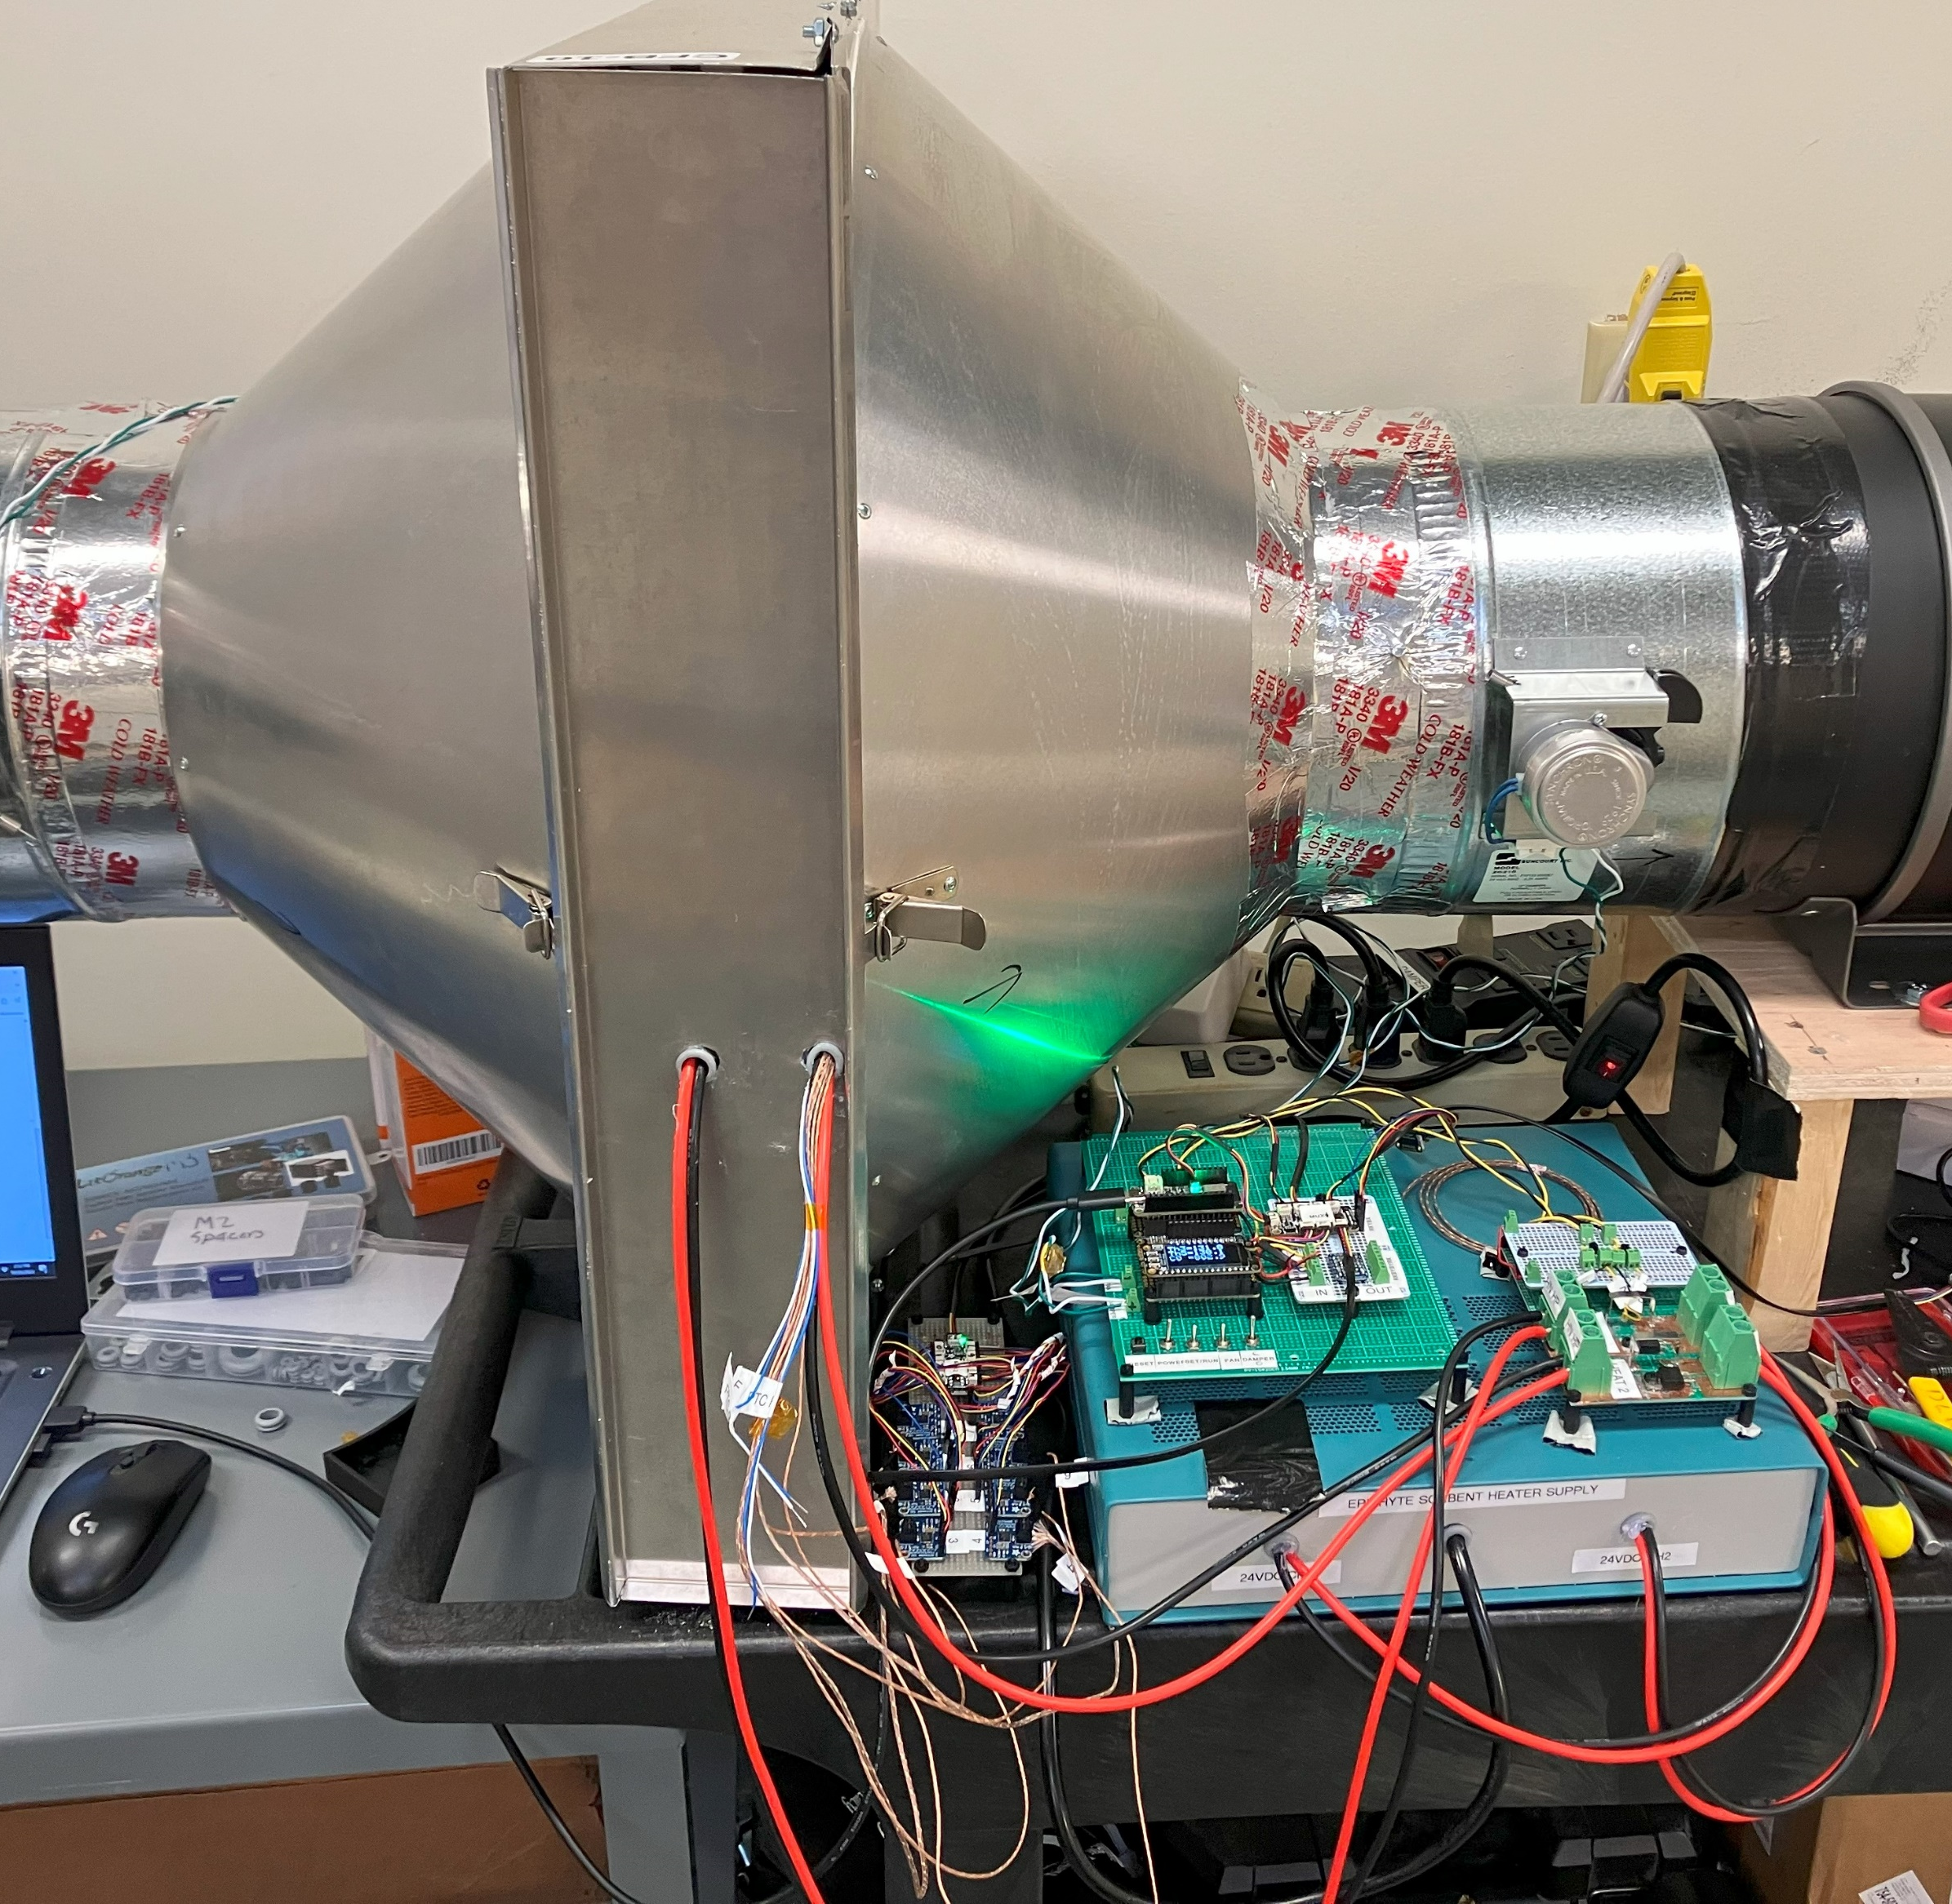
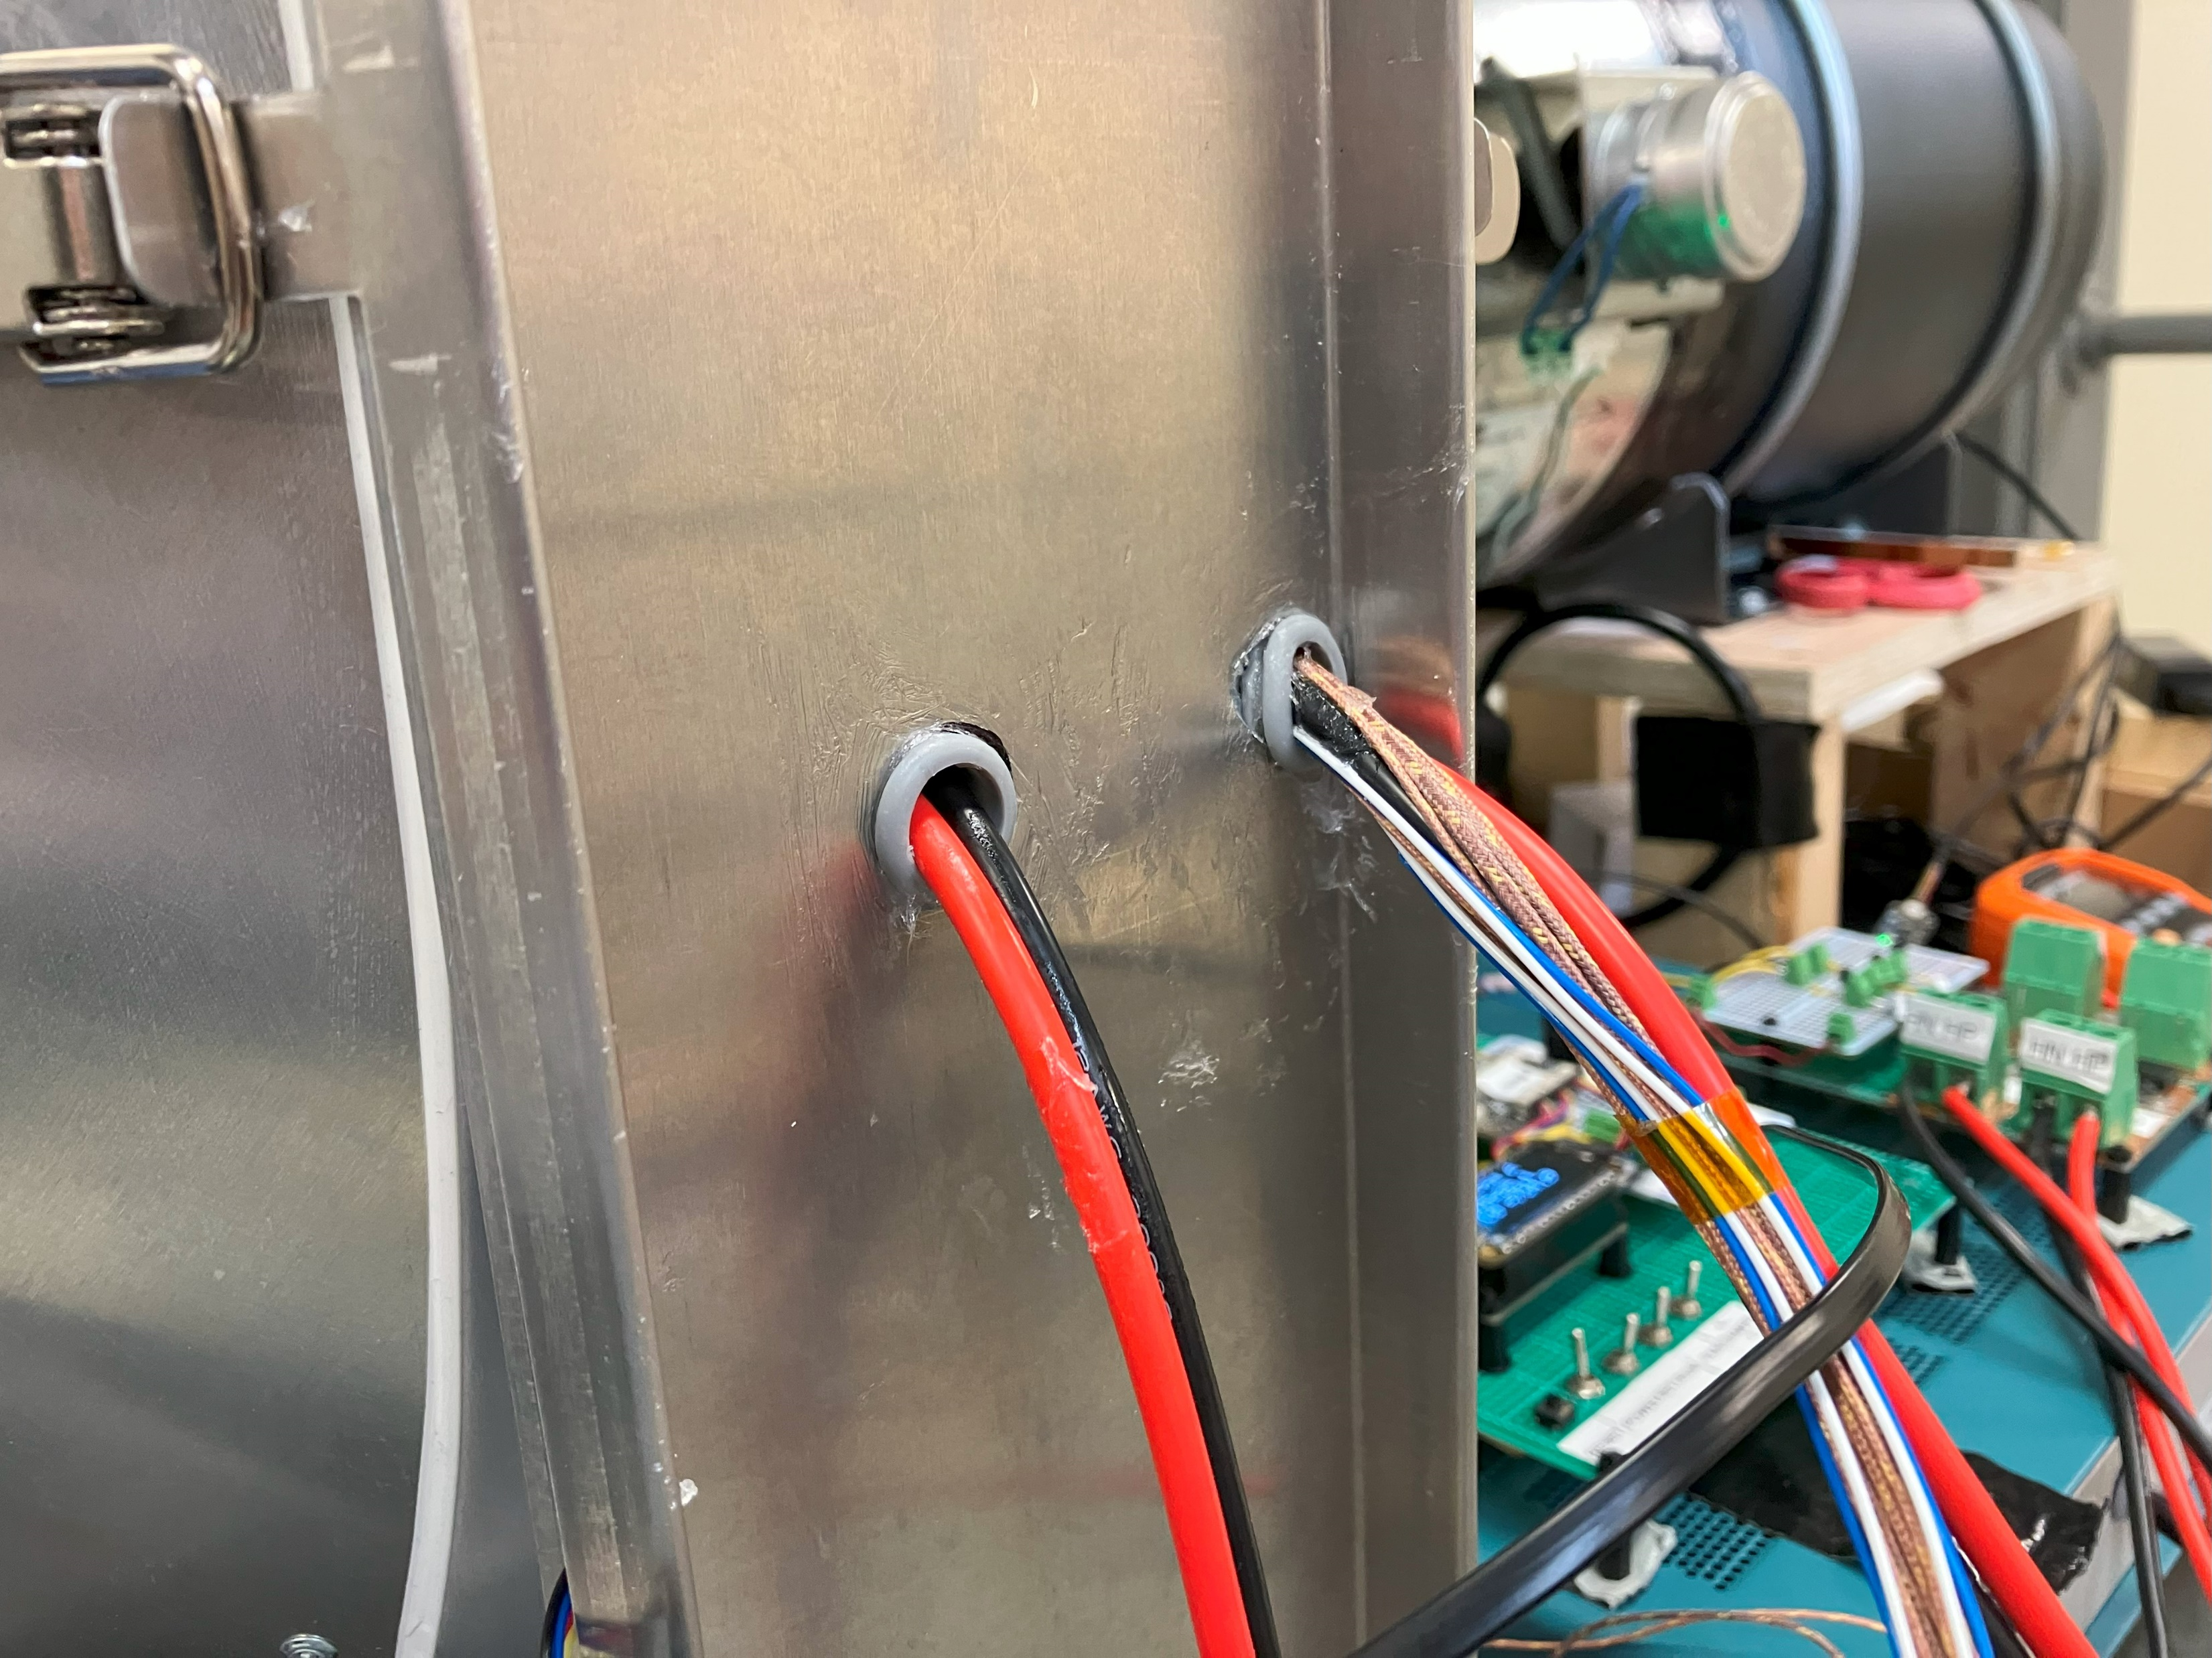
Sorbent Panel Cleanup
After!

Slide 4
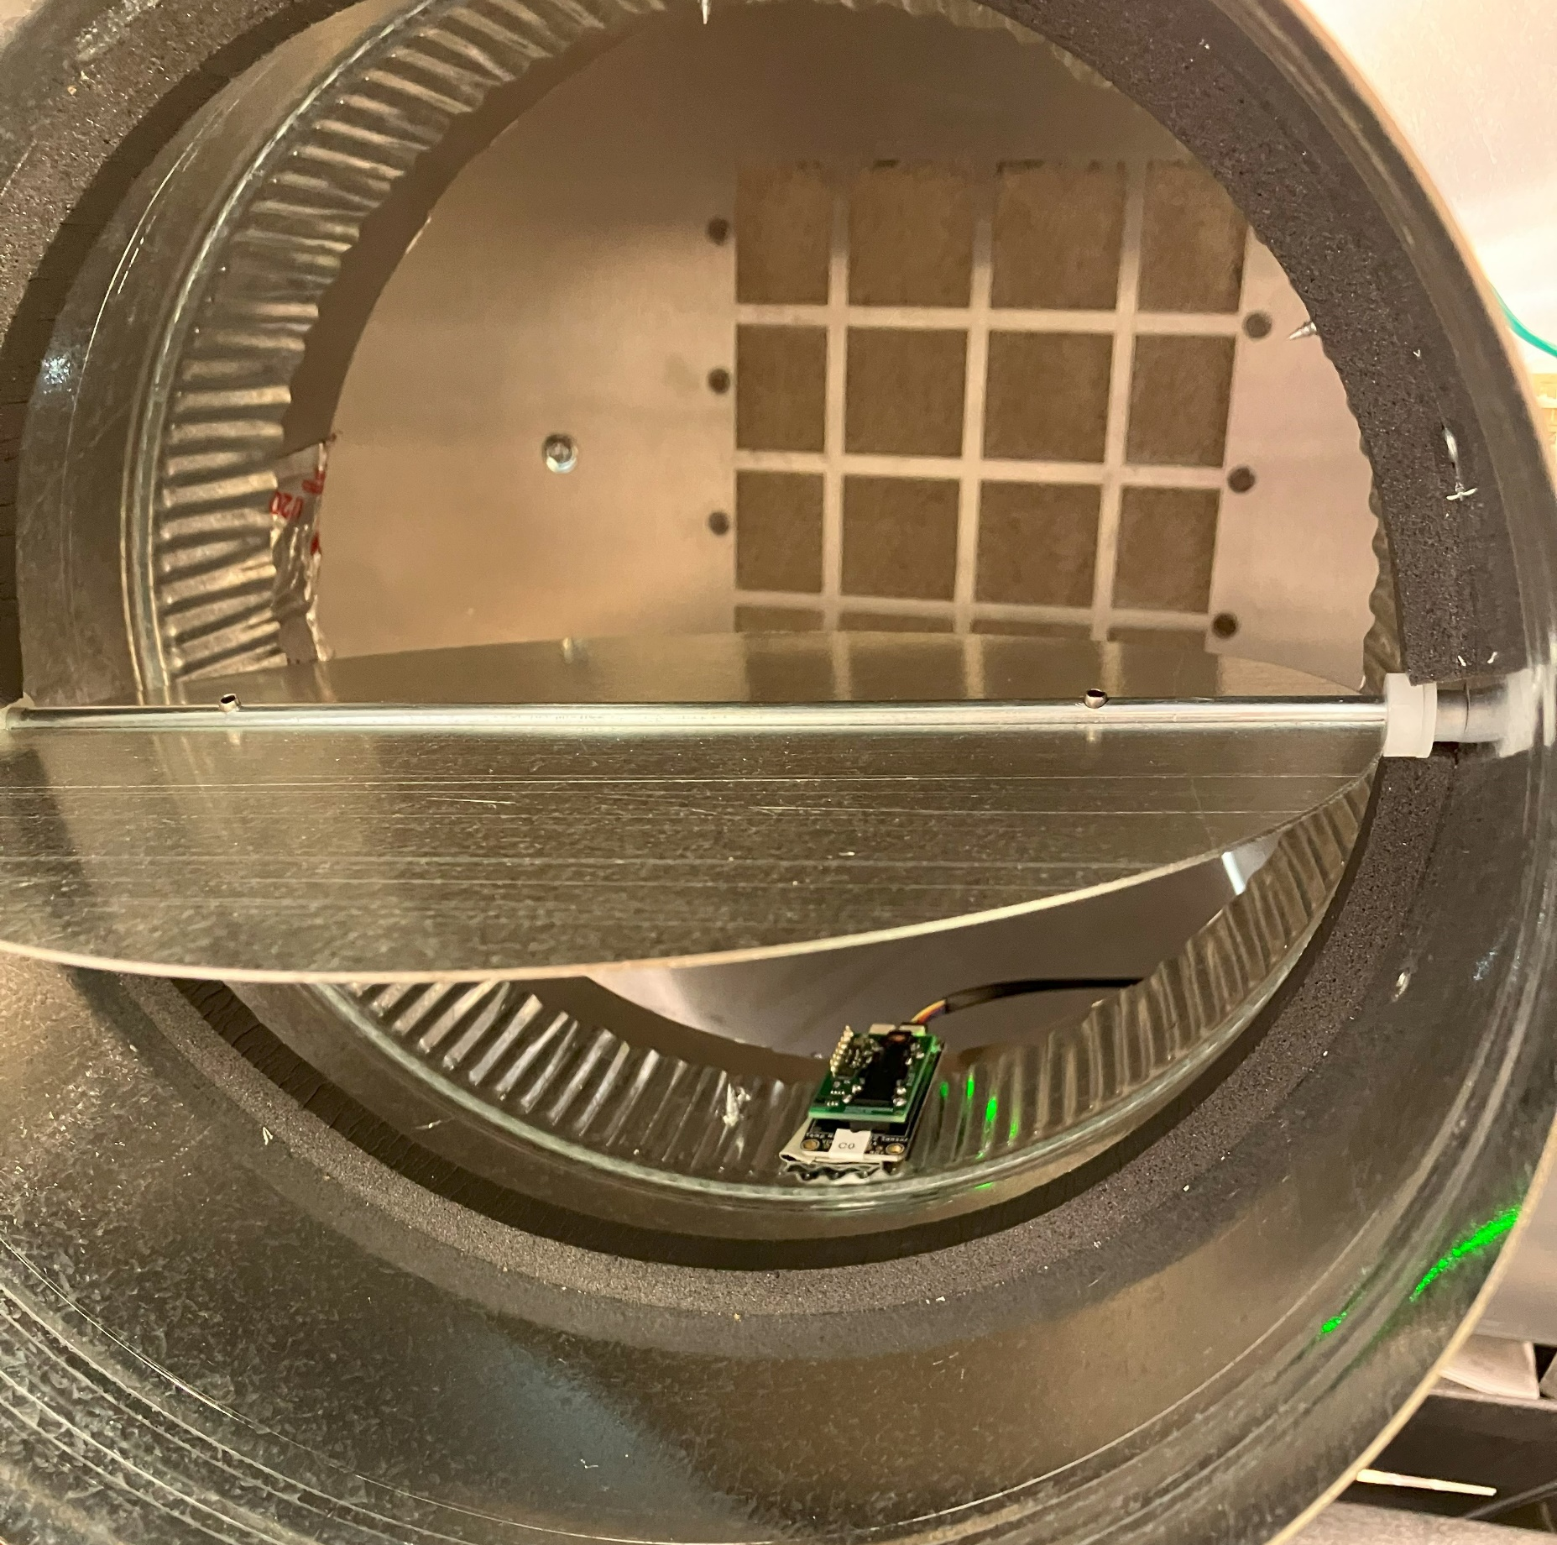
DESORPTION: Heat Only
DAMPER 1
DAMPER 2
FAN 2
T
C
T
T
CLOSED
CLOSED
OFF
T
HEATER ON
T
TEMPERATURE
C
CO2, HUMIDITY, AND TEMP

Slide 5
First CO2 Test: Heat Sequence
Open Damper, Fan ON for 1 minute
Open Damper, Fan ON for 1 minute

Slide 6
First CO2 Test: CO2 and H2O Release
Open Damper, Fan ON for 1 minute
Open Damper, Fan ON for 1 minute

